Slide 1
UCSD Embedded C Assignment 5
By
Hsuankai Chang
hsuankac@umich.edu

Slide 2
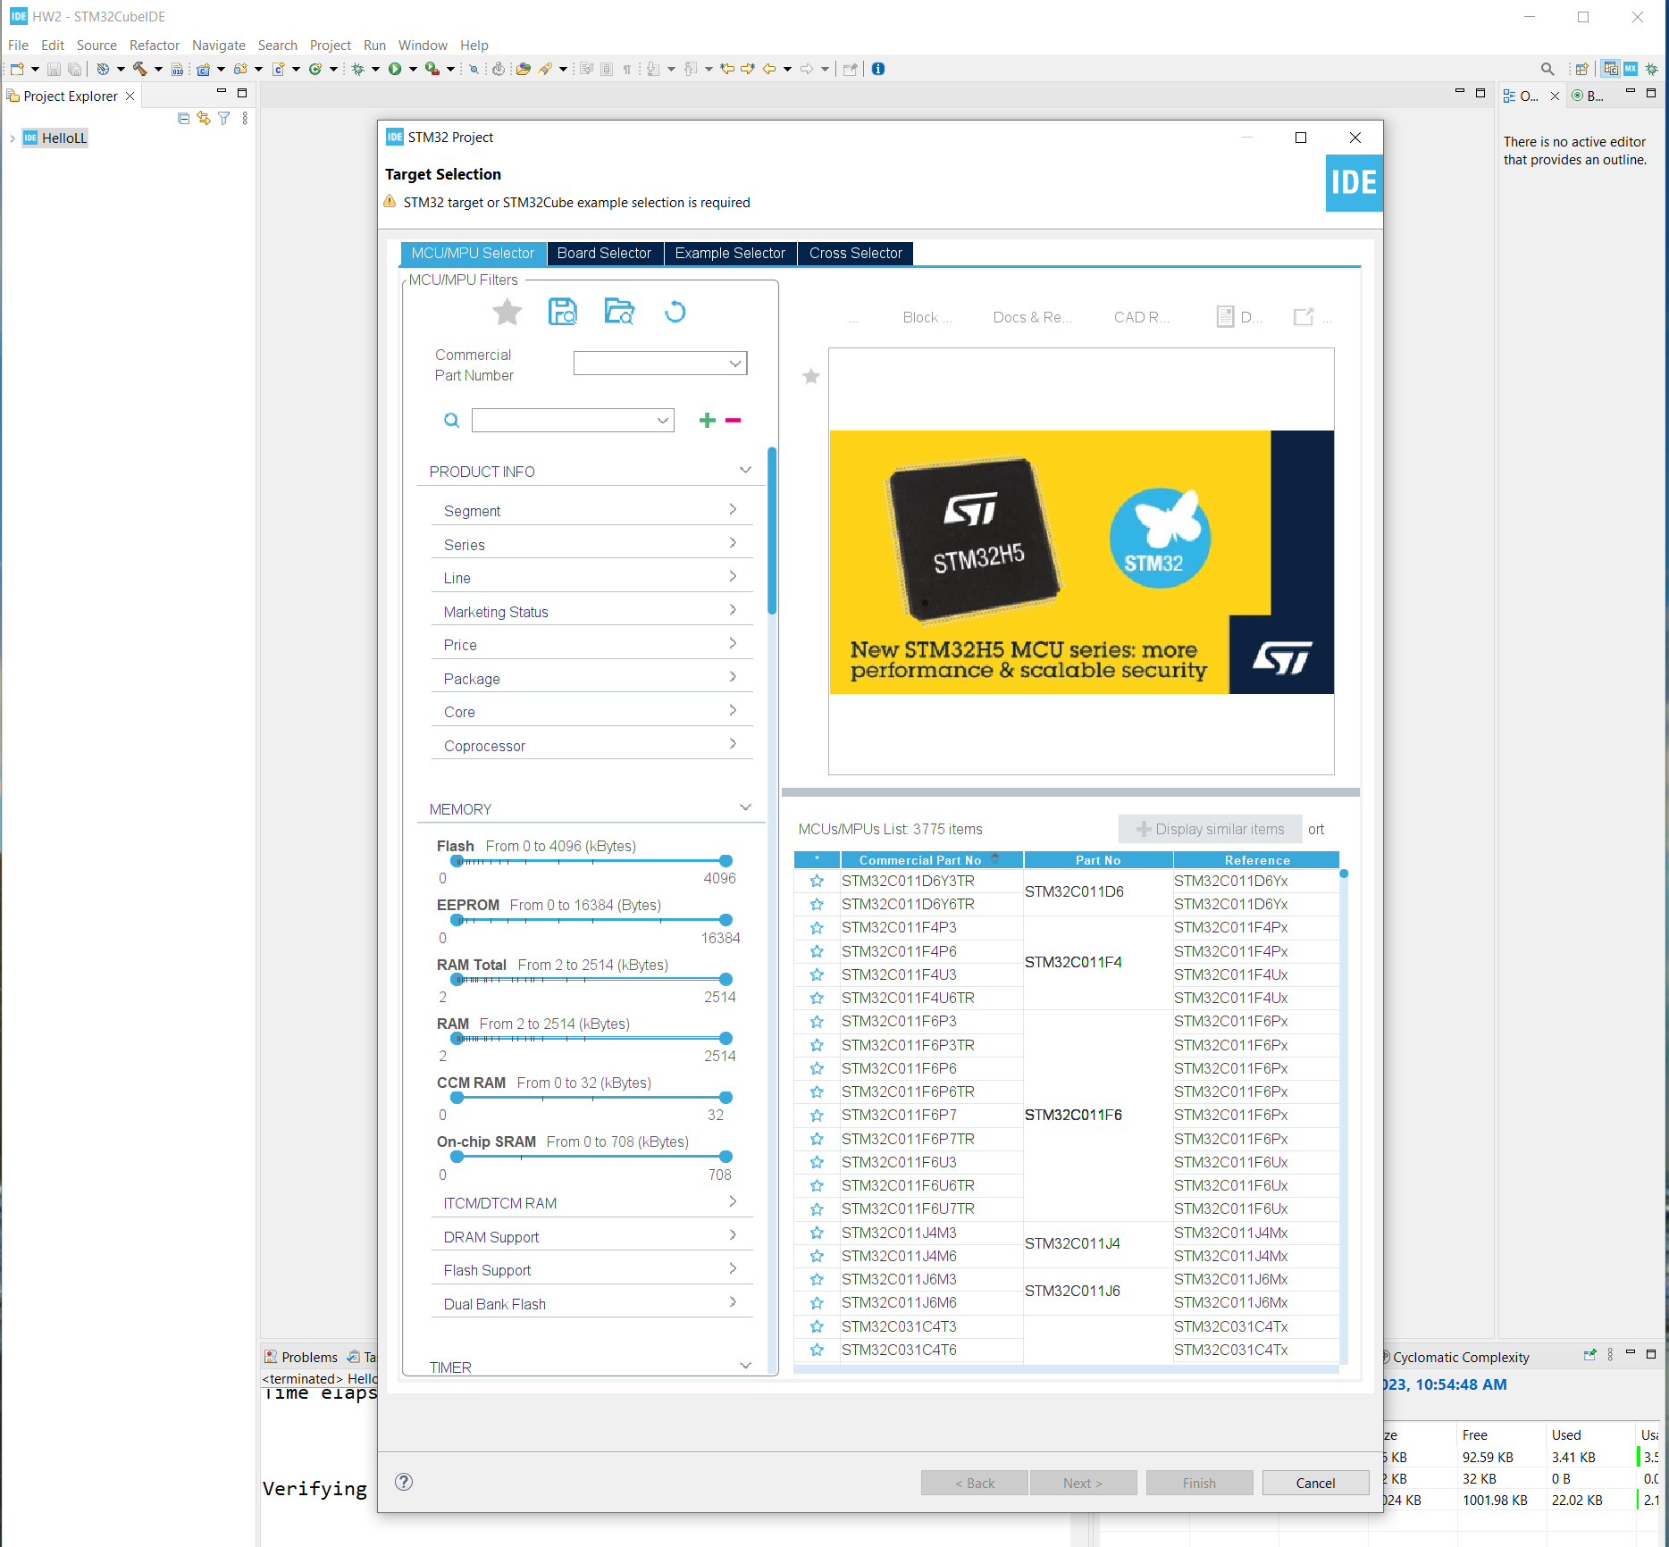
Step 1. Startup STM32CubeIDE and create new STM32 project

Slide 3
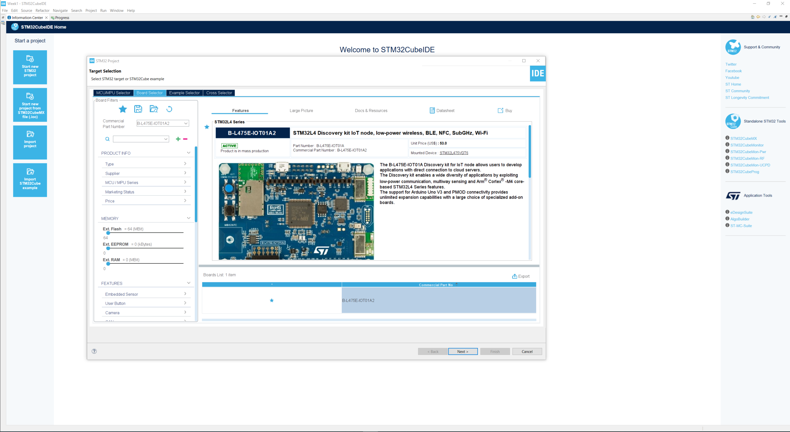
Step 2. Access board selector and type in the board you use, click Next

Slide 4
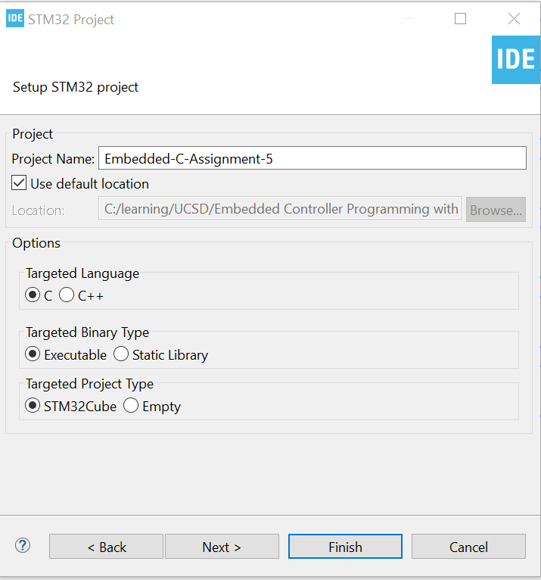
Step 3. Enter the project name then click Next

Slide 5
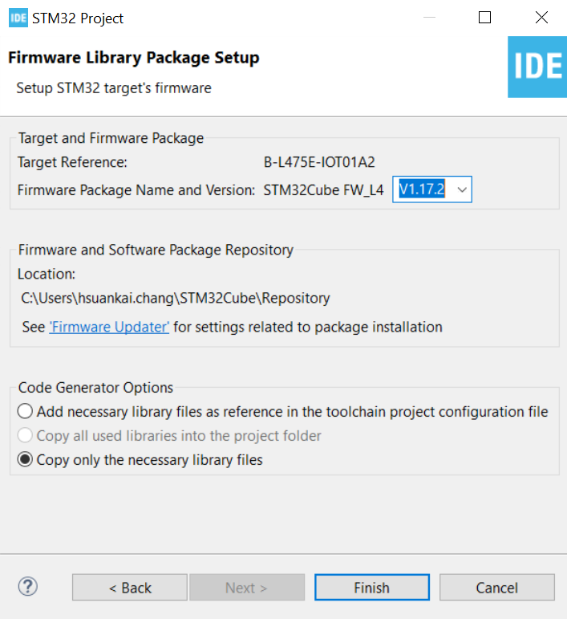
Step 4. See the firmware package name and version

Slide 6
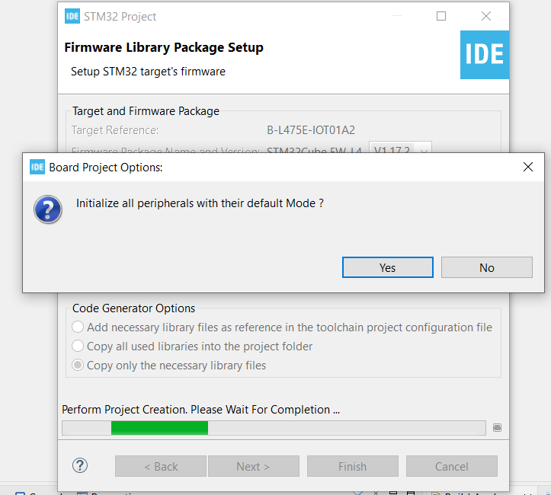
Step 5. Click yes to initialize all peripherals to default

Slide 7
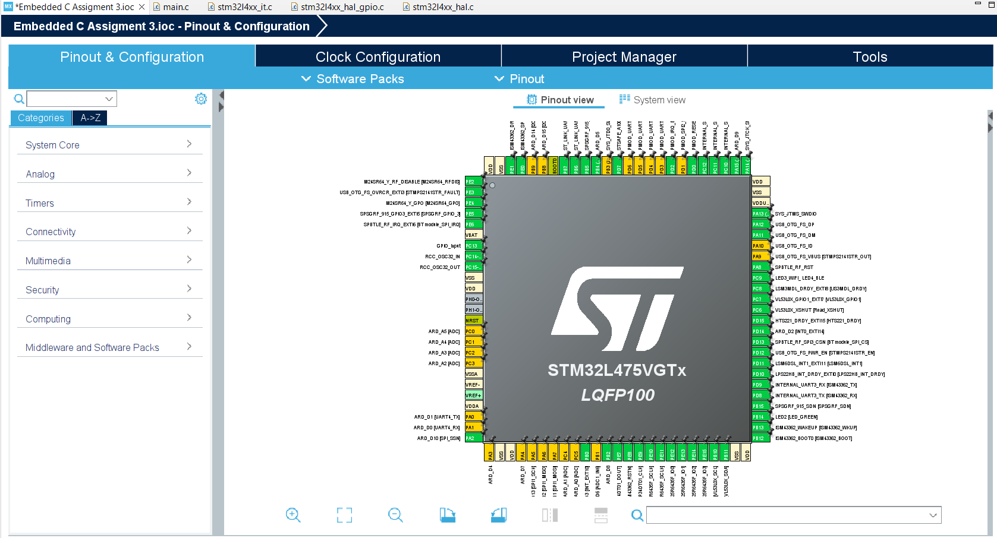
Step 6. When in .ioc file, click Pinout & Configurations

Slide 8
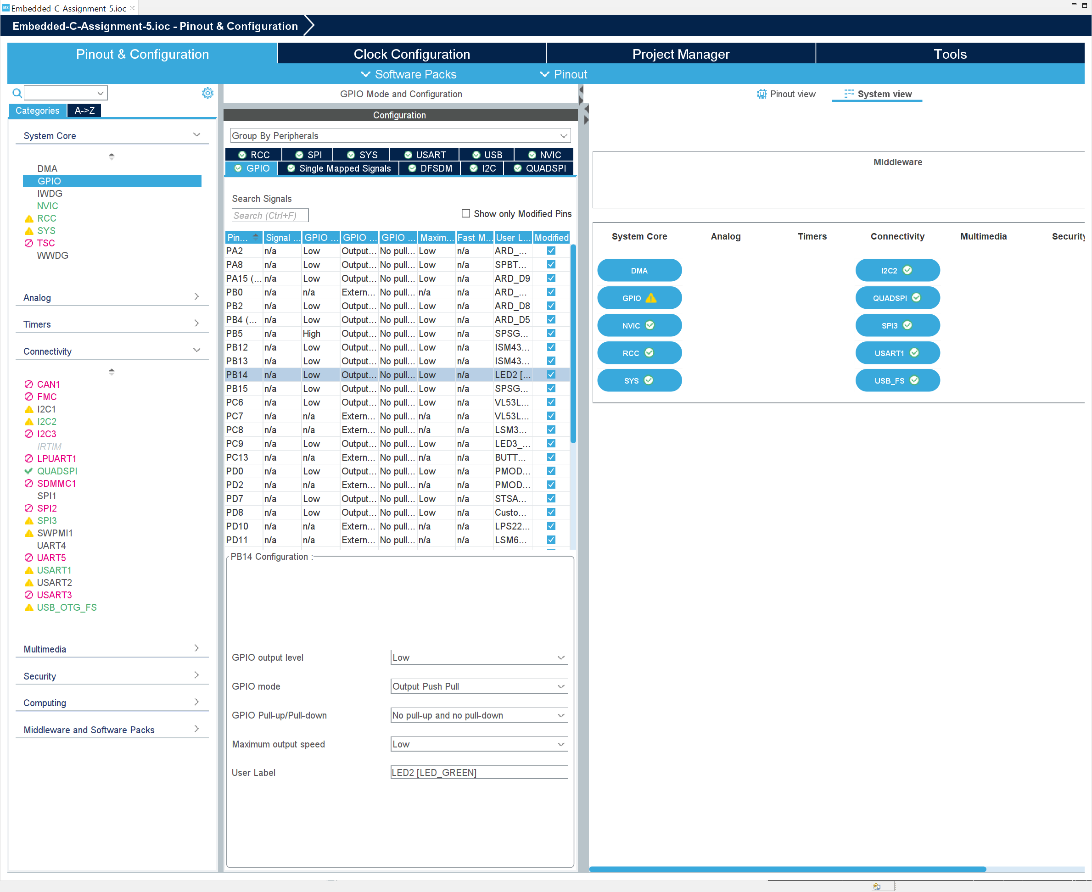
Step 7. Review the LED2 GPIO configuration by clicking System view -> GPIO -> PB14

Slide 9
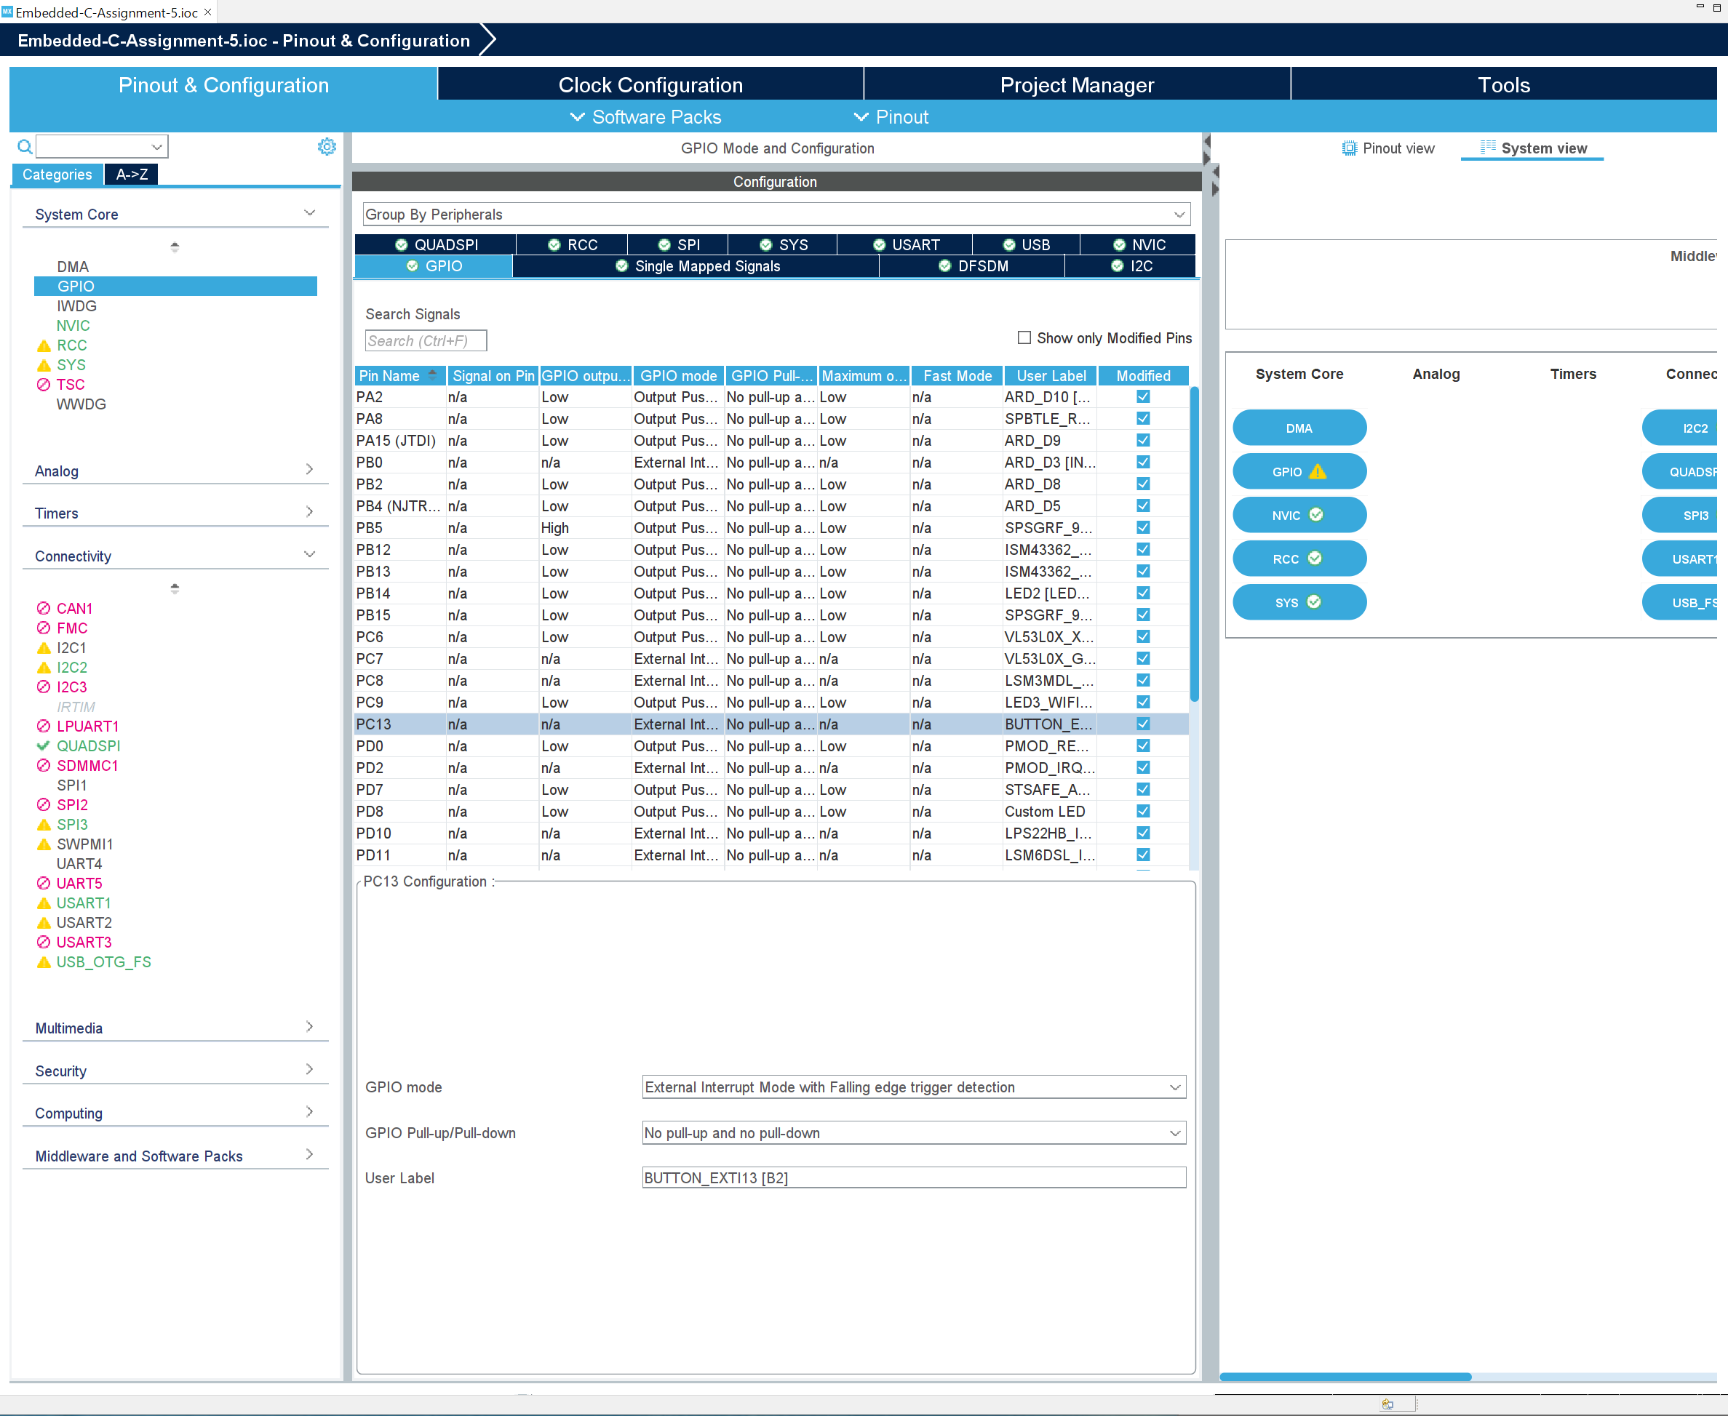
Step 8. Review the BUTTON GPIO configuration

Slide 10
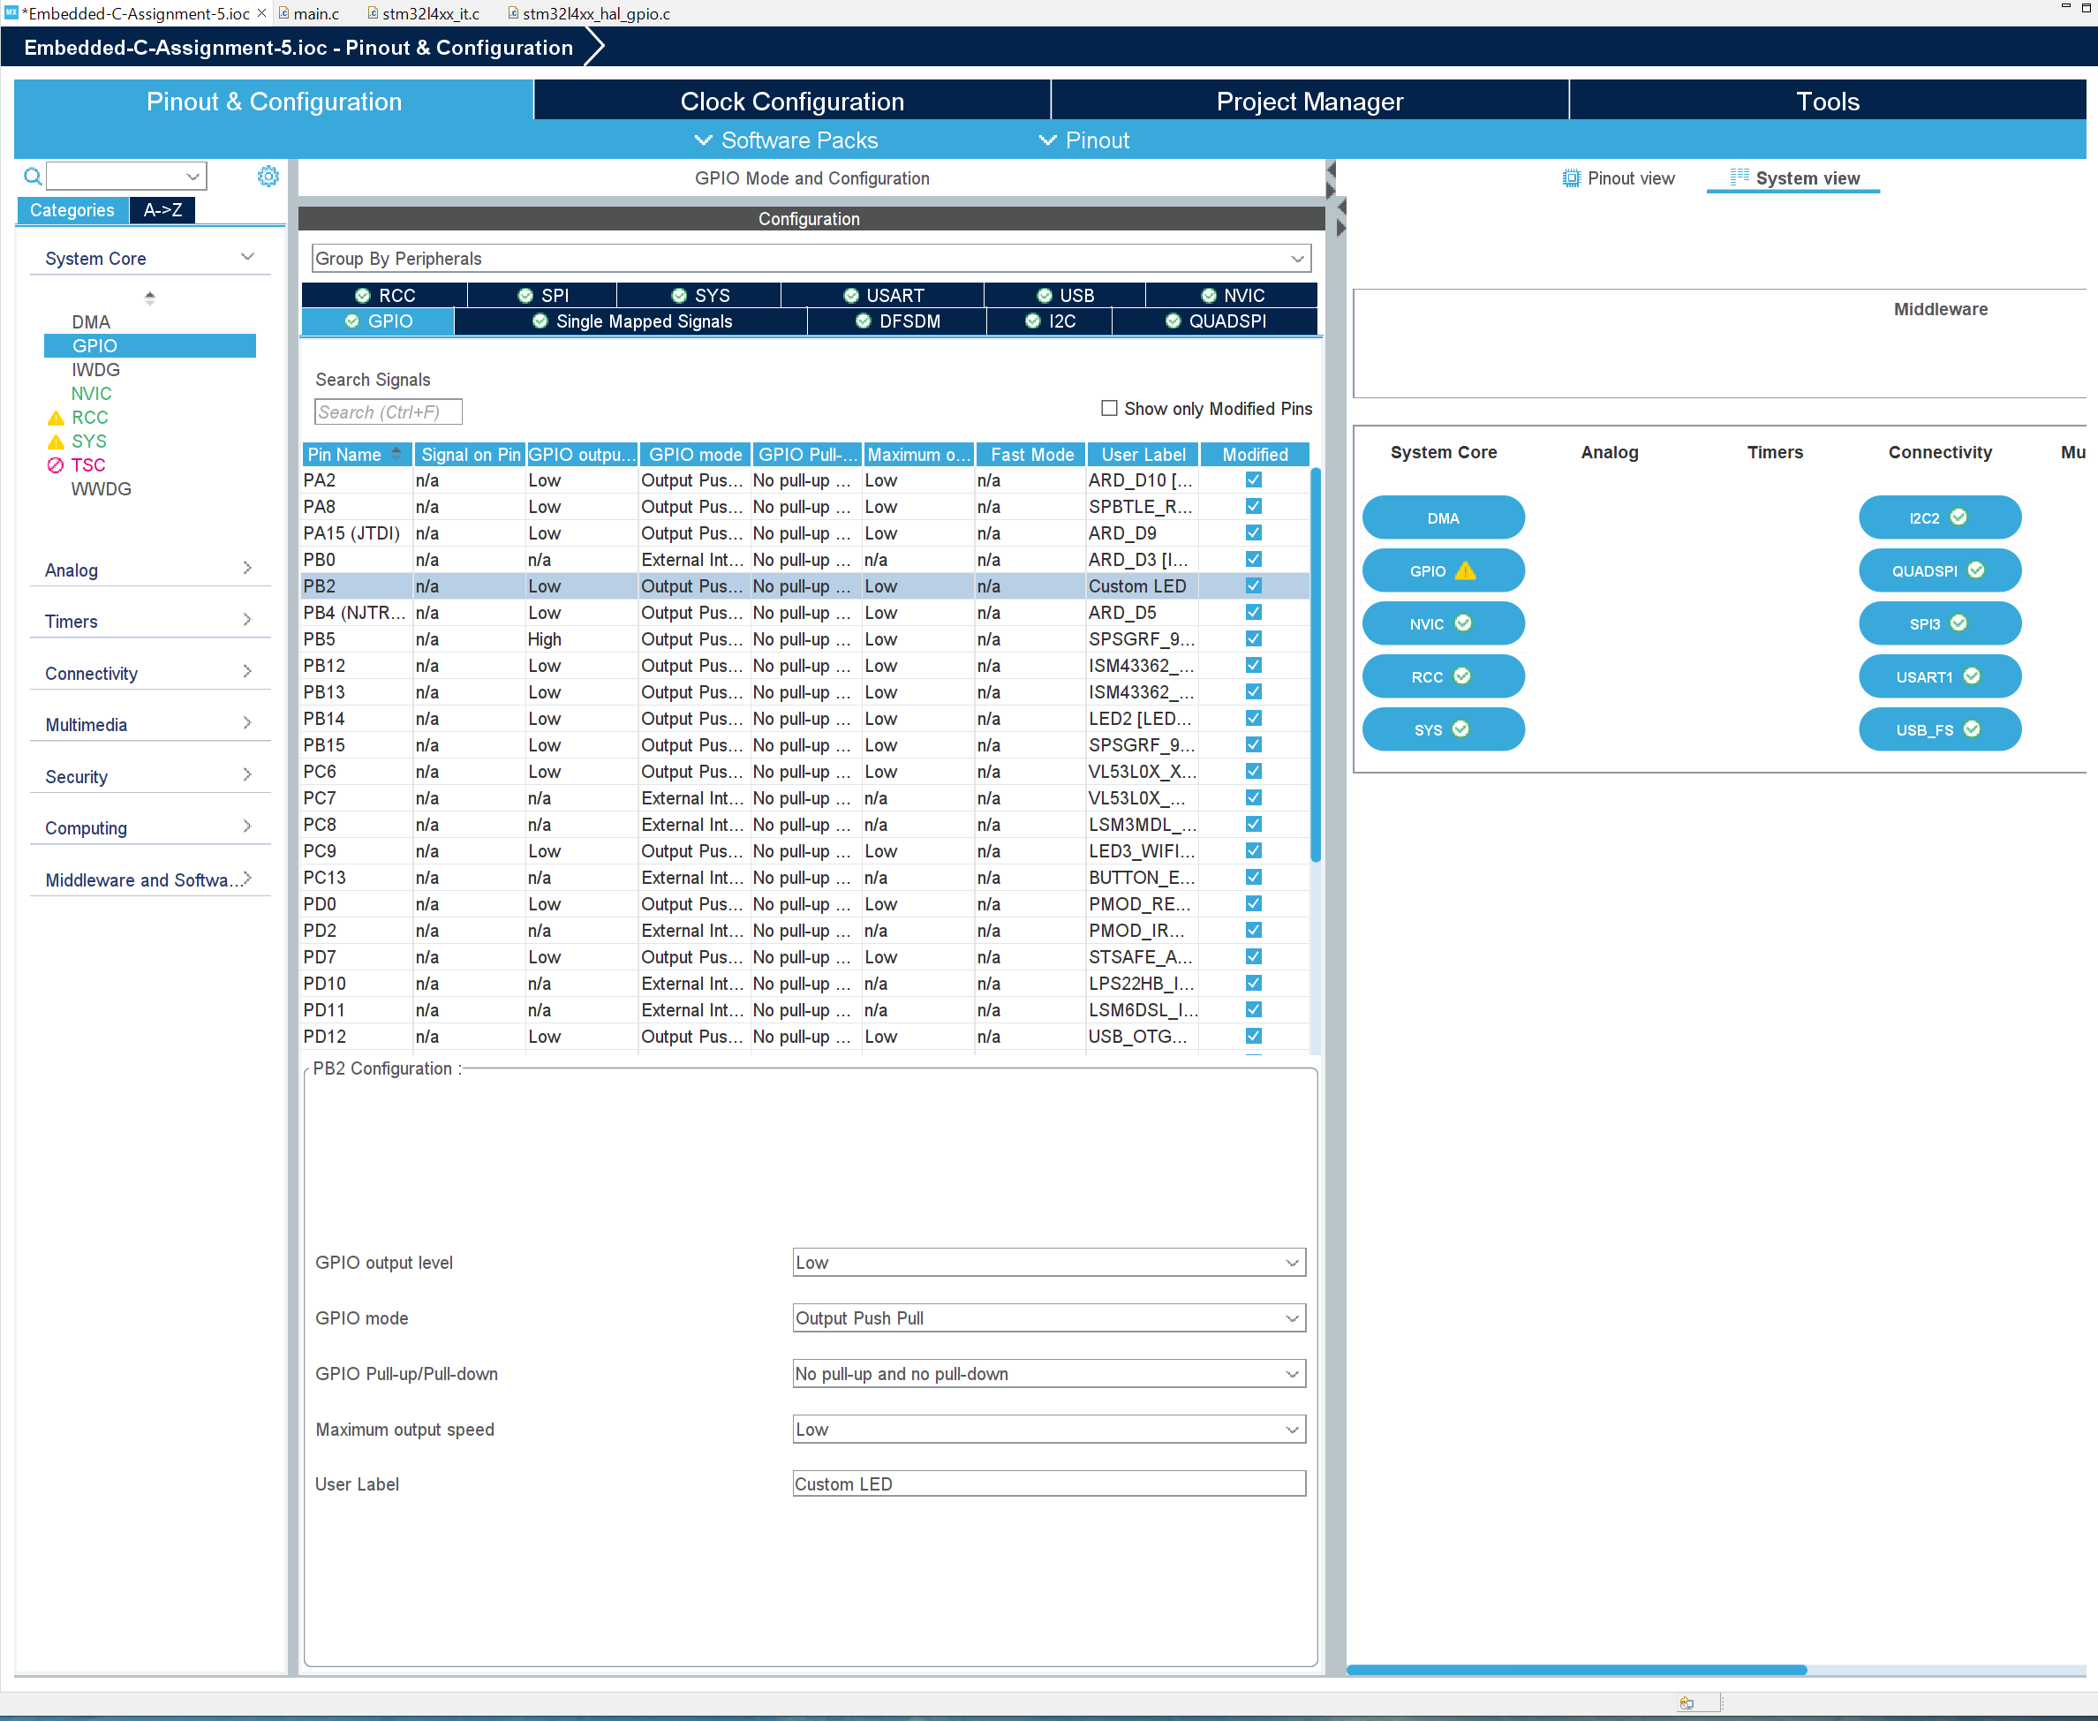
Step 9. Review the PB2 Pin GPIO configuration (D8 on the board), I name it Custom LED

Slide 11
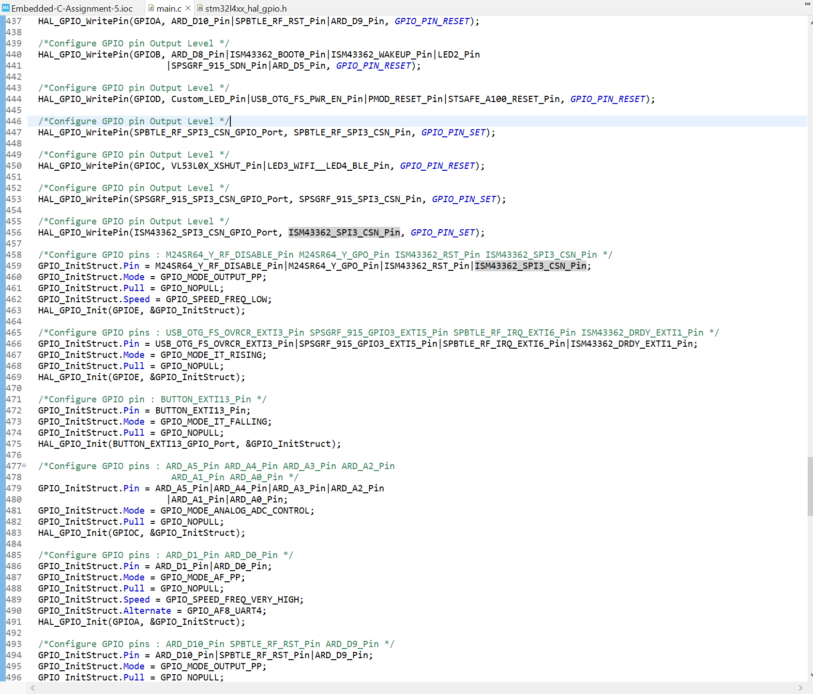
Step 10. Generate code, and review the code that initialize the button interrupt

Slide 12
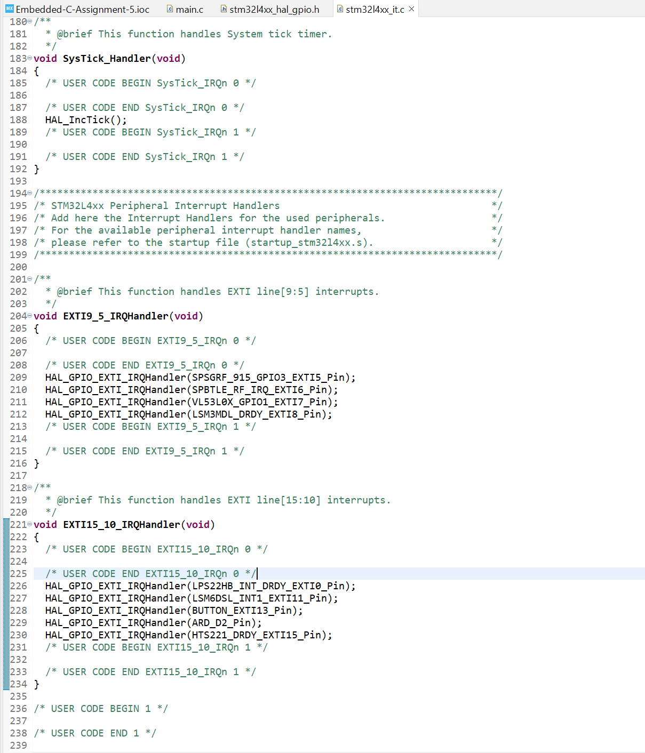
Step 11. In stm32l4xx_it.c, find interrupt handler code

Slide 13
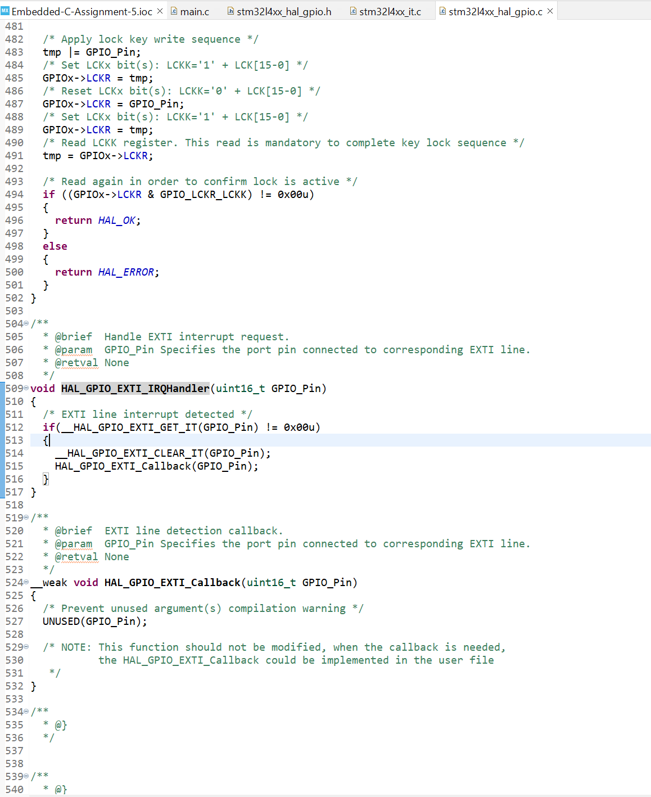
Step 12. In stm32l4xx_hal_gpio.c, find HAL_GPIO_EXTI_IRQHandler code

Slide 14
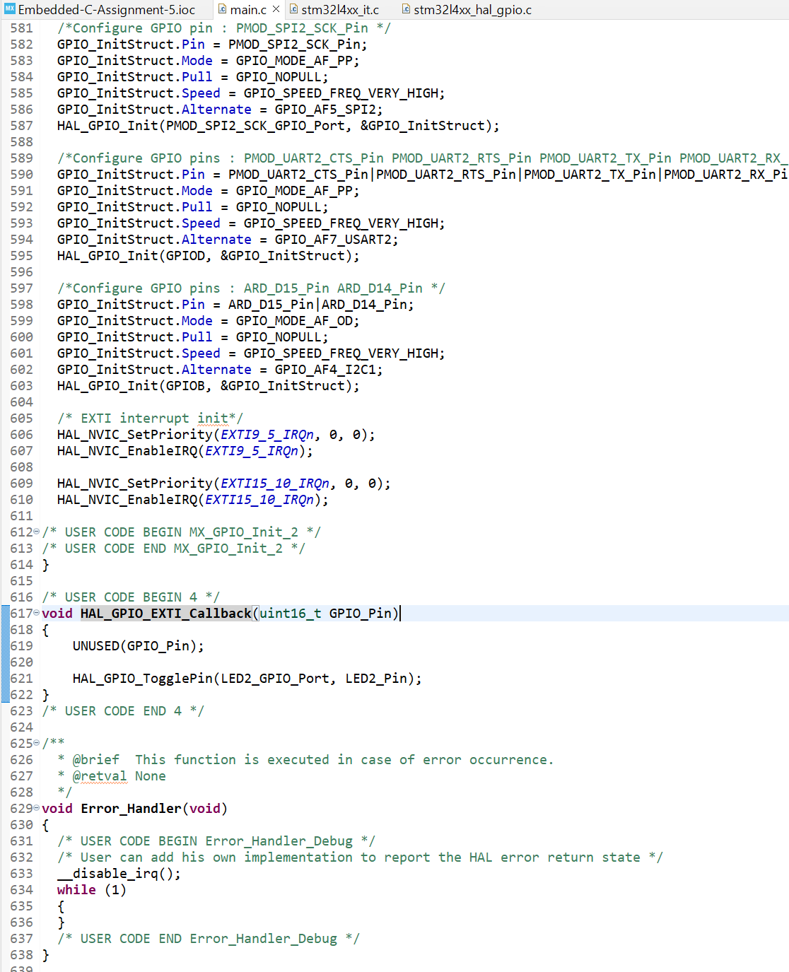
Step 13. In main.c, add interrupt code to toggle LED on interrupt

Slide 15
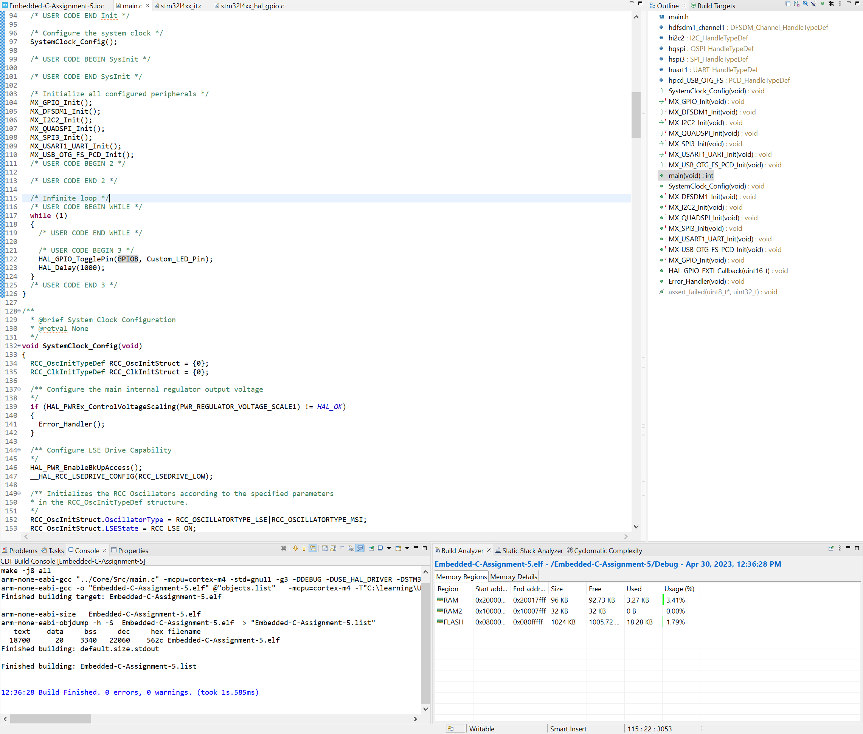
Step 14. In main.c, add code to toggle PD8 GPIO pin at 1 second rate

Slide 16
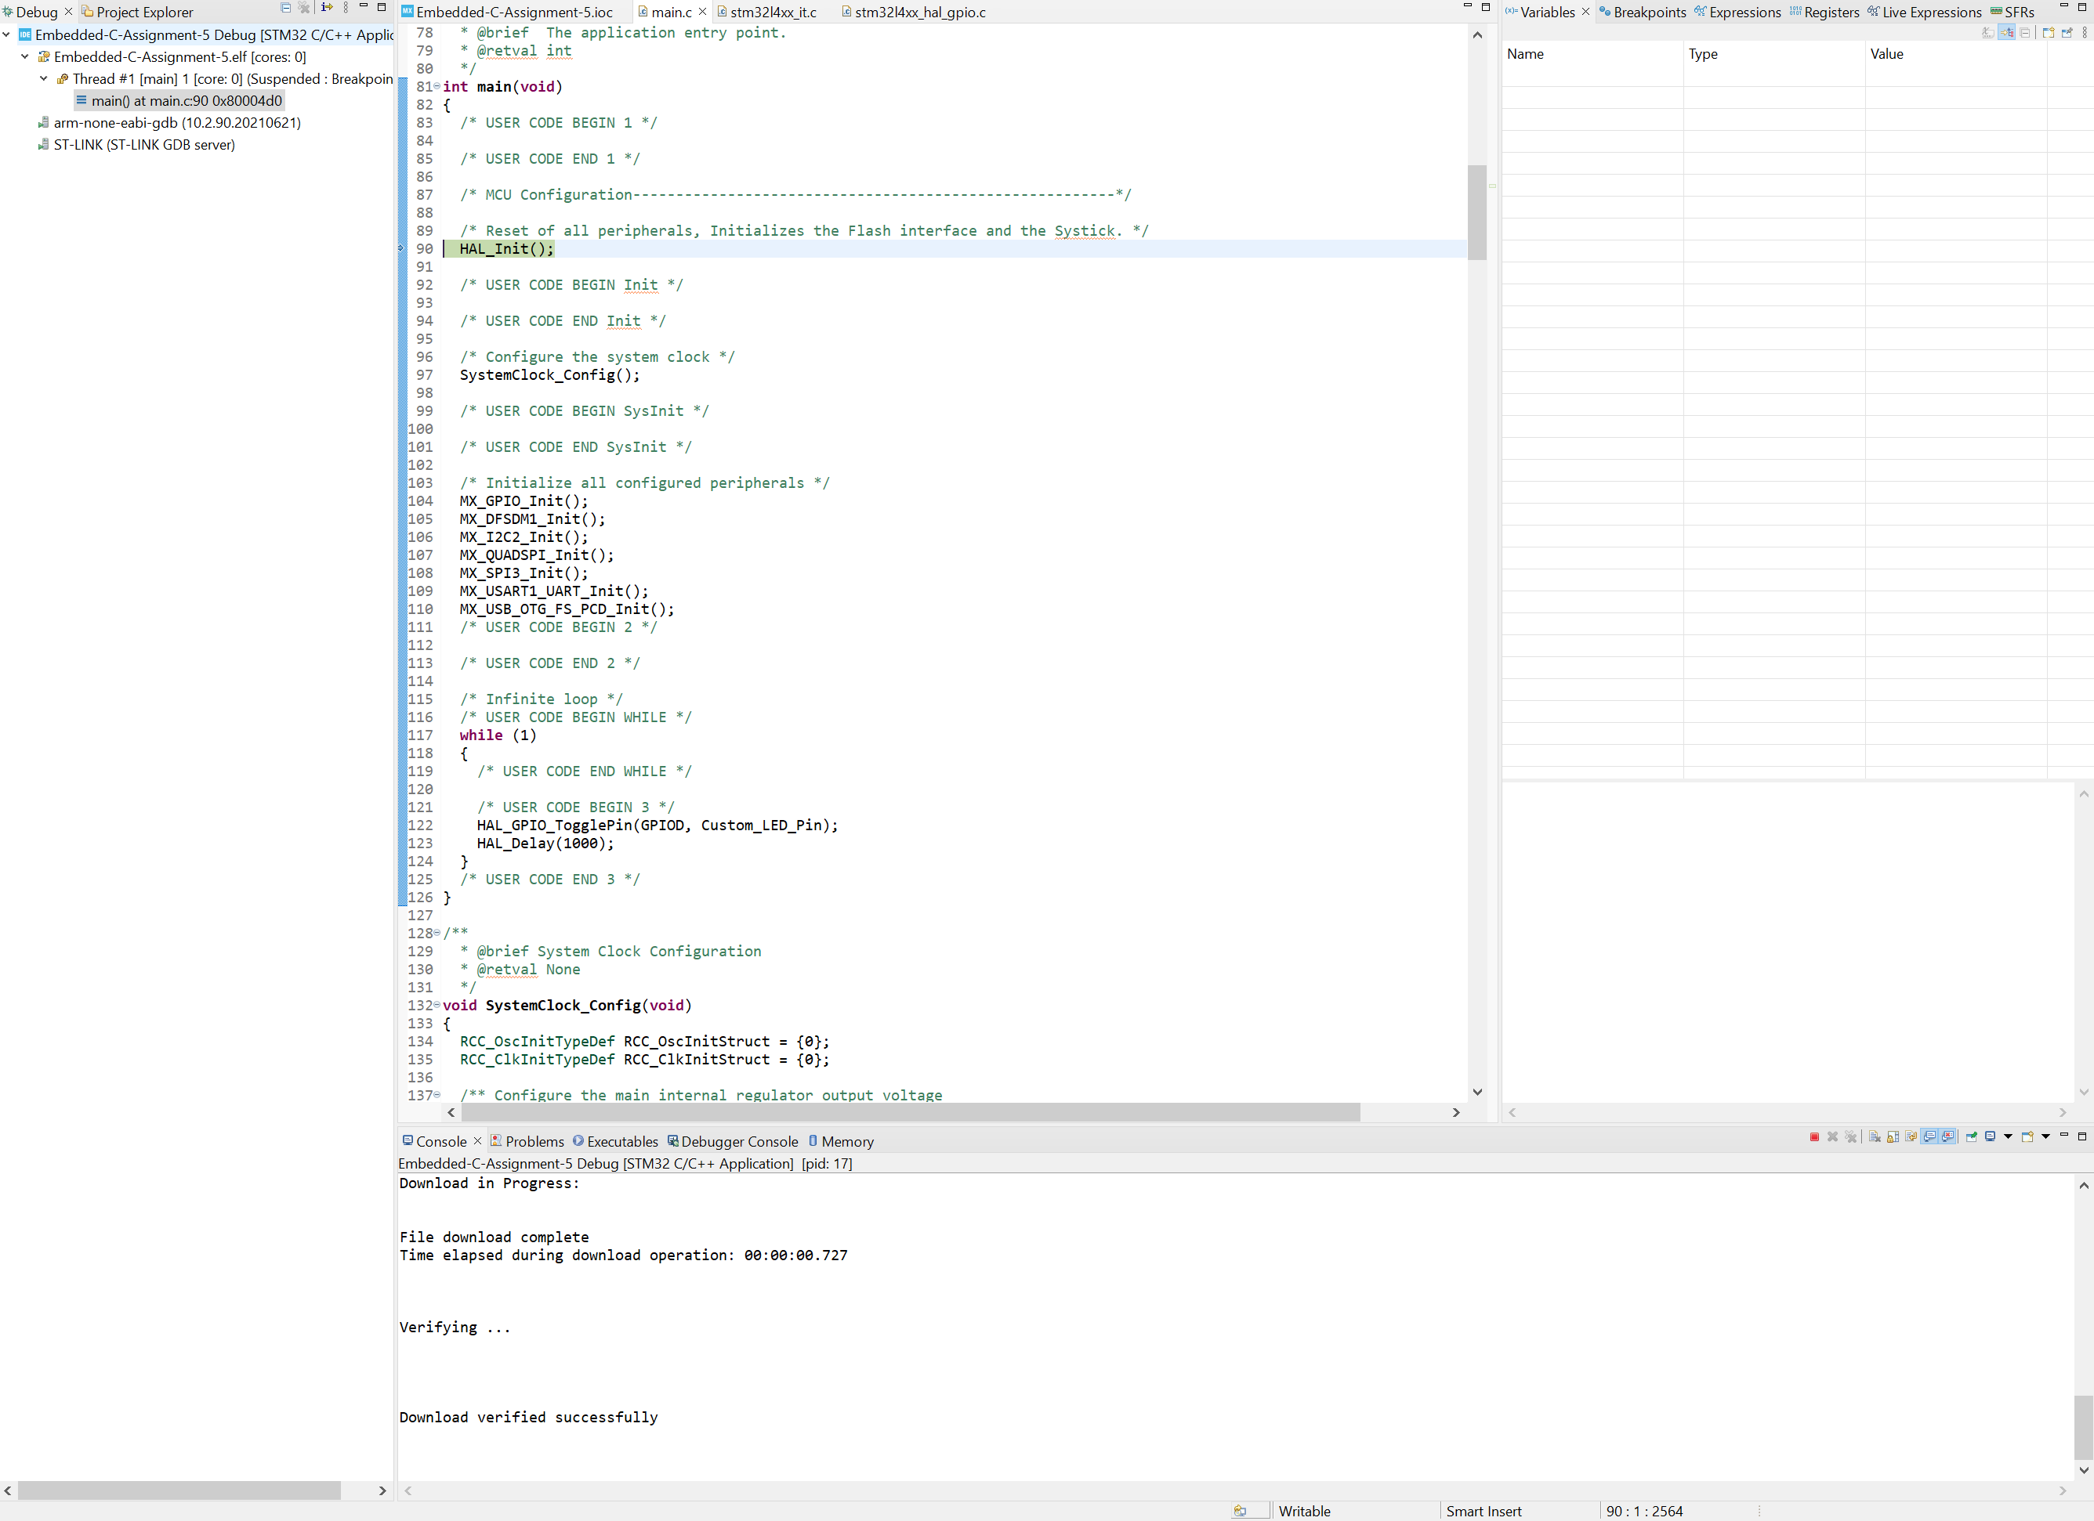
Step 15. Build and run the project in debug, when press button, you should see LED2 toggle, and every 1 second, you should also see PD8 toggle LED pin

Slide 17
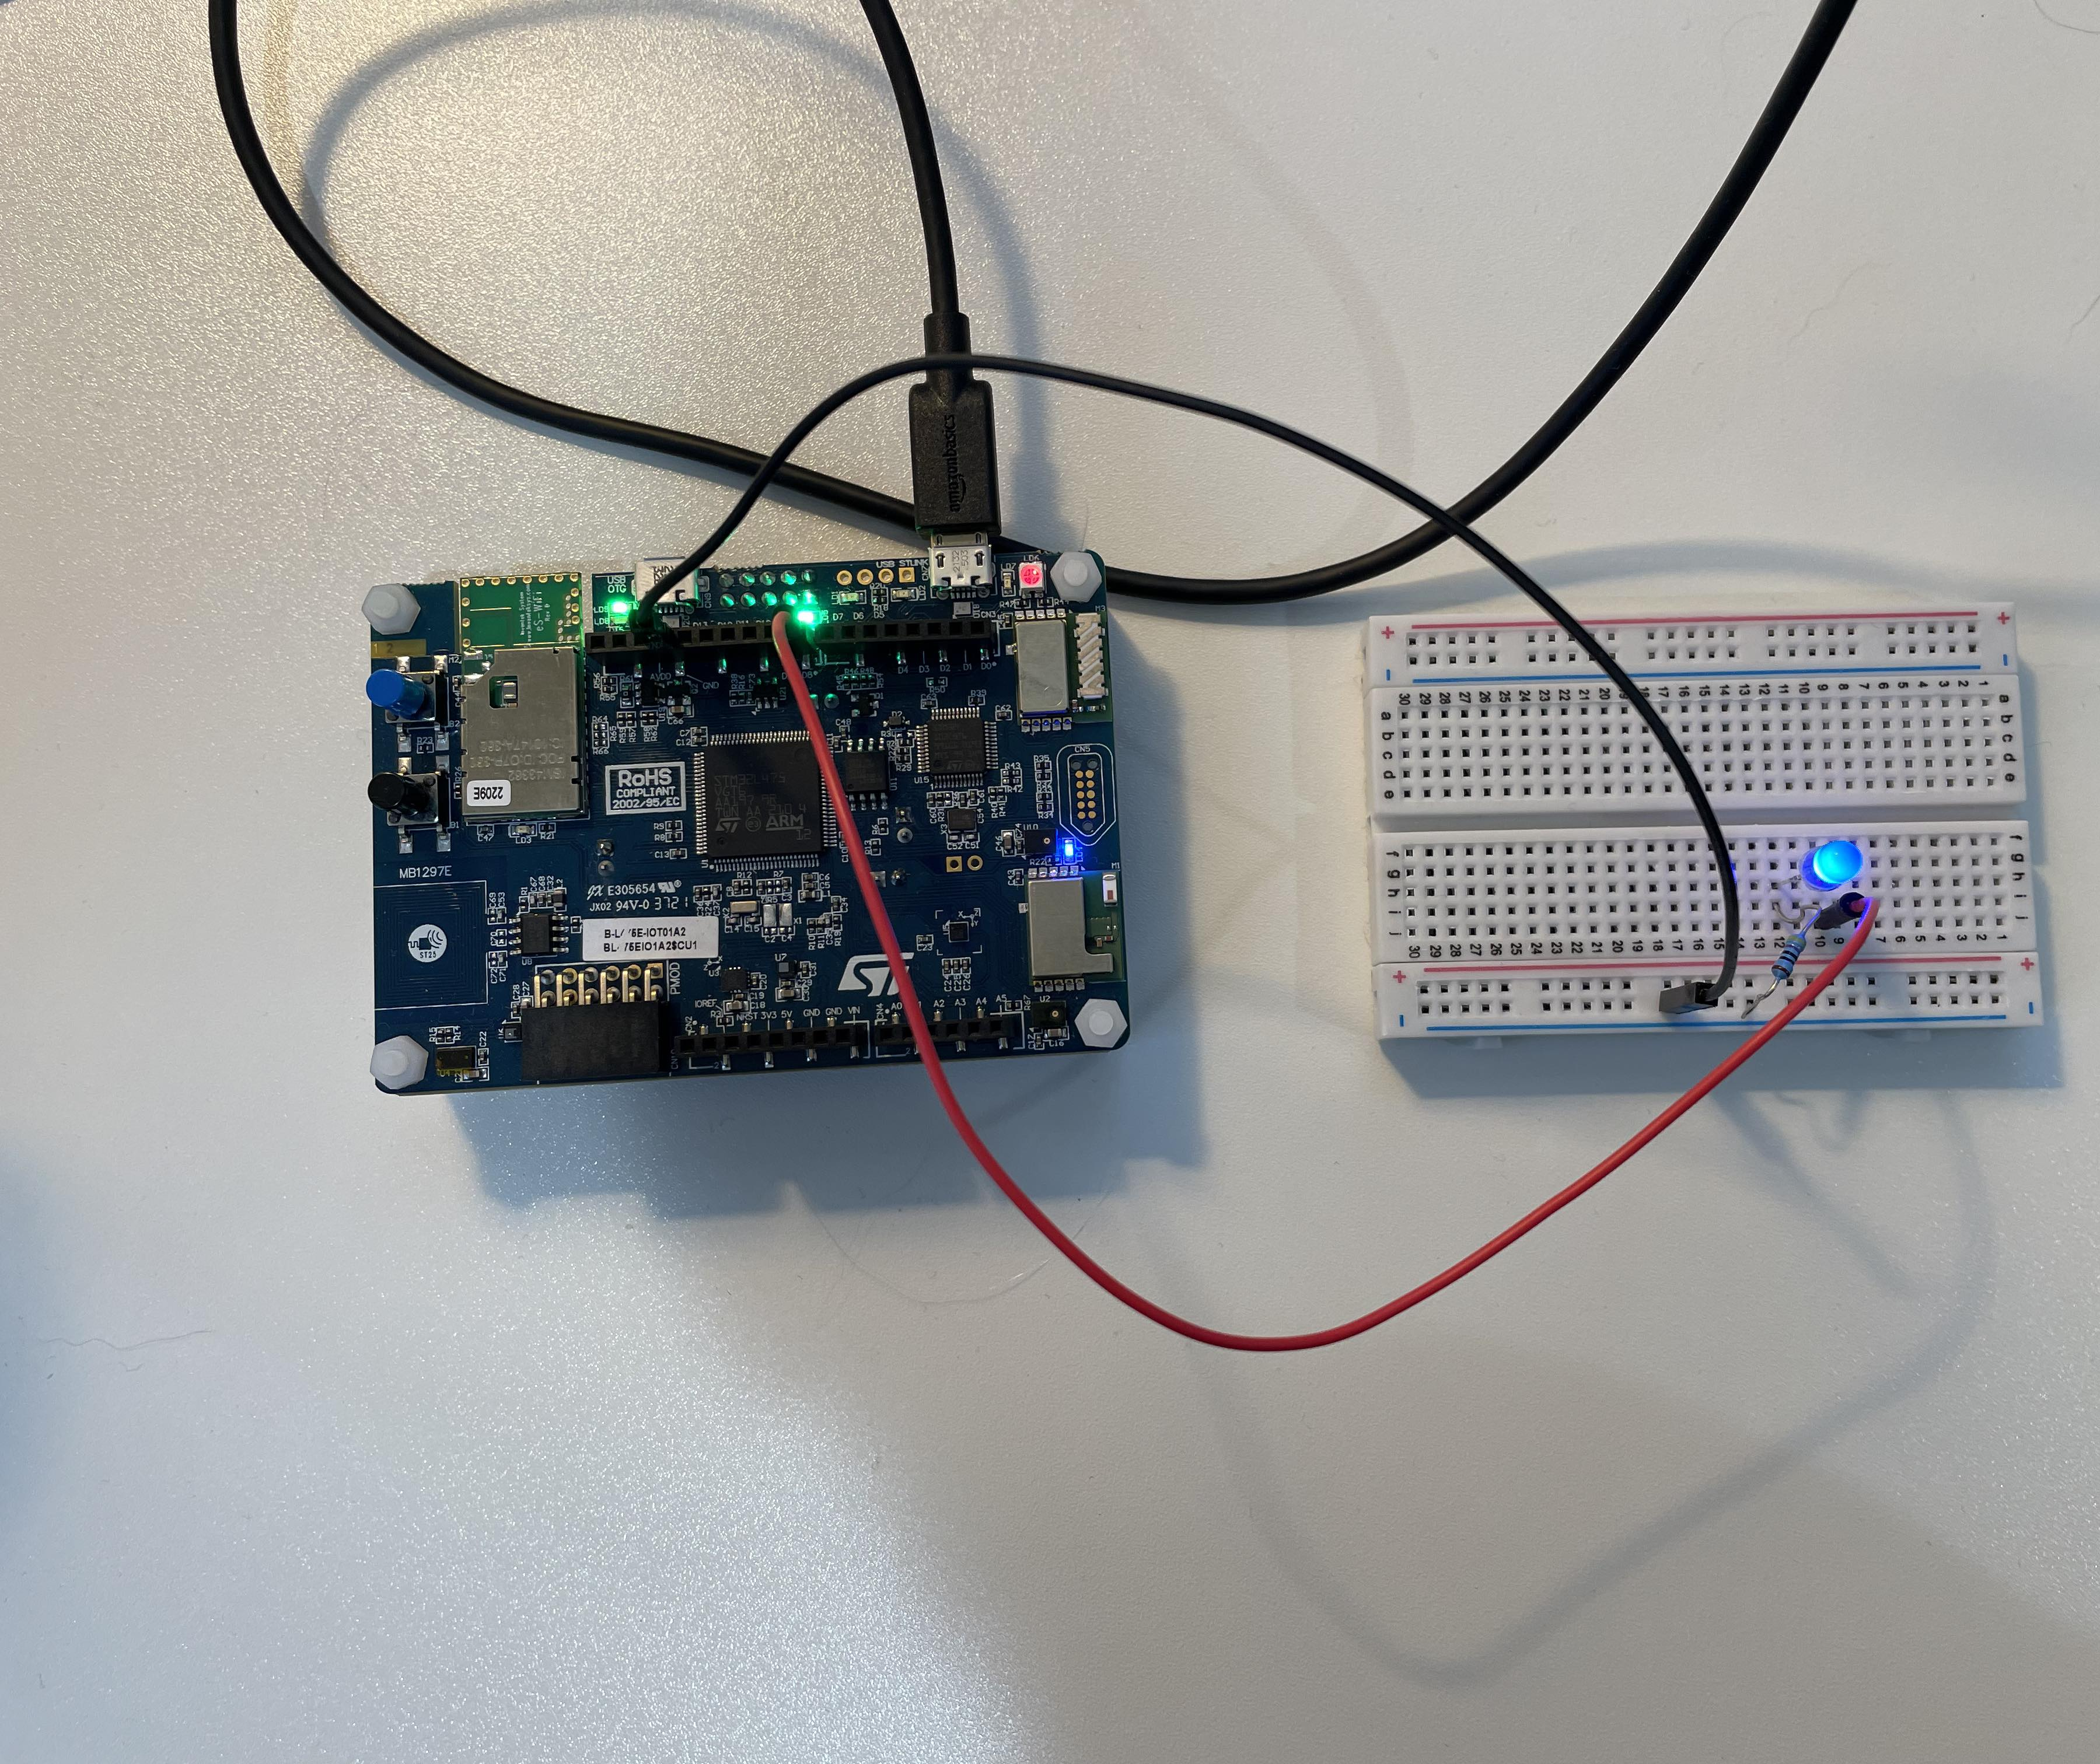
Appendix. Attachment is the hardware connection for PD8 LED

